Slide 1
Reliability in Time-Dependent Failure Models
Unit 8A
Spring 2022

Slide 2
References
Ebeling, C.E., Introduction to Reliability and Maintainability Engineering, 3^{nrd} ed, Waveland Press, 2019, Chapter 4 (Ebeling, 2019)
Modarres, M., M. Kaminskiy, V. Krivtsov, Reliability Engineering and Risk Analysis, 2nd ed, Taylor & Francis, 2010 (Modarres, RERA)
Rausand, M. and Hoyland, A., System Reliability Theory, 2nd edition, Wiley, 2004

Slide 3
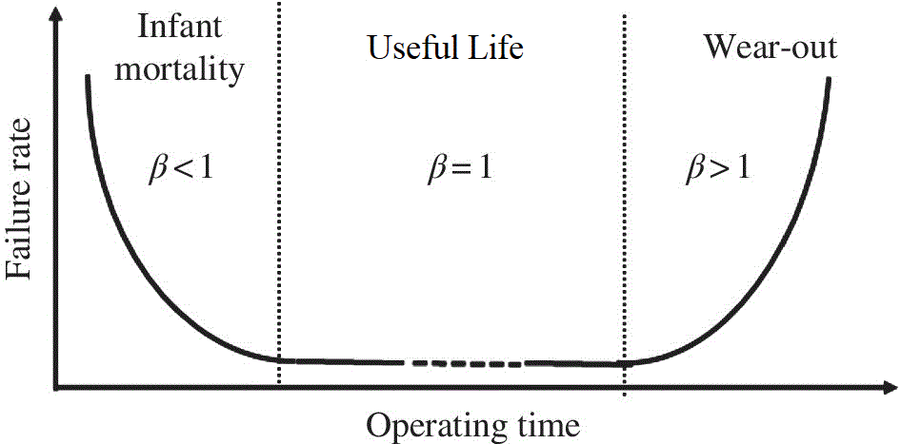
A good failure model can capture the characteristics of failure
Bathtub curve shows failure rate λ against time t
For the flat section, λ is constant
Exponential
For IFR and DFR, λ is a function of t: λ(t)
Weibull
Normal
Lognormal
Gamma

Slide 4
Time Dependent Failure Mode
Values of λ under many conditions are not constant with time, so a time dependent failure rate model is needed
In its simplest form, we can write λ(t) = at^{b}
For b=1, λ(t) becomes linear
For b = 0, λ(t) = constant λ (Exponential)
Rewrite at^{b} to result in a simpler function for the Weibull distribution:
β is the shape parameter. θ, the scale parameter

Slide 5
Reliability Function for Weibull Failure Distribution
Inserting the expression for λ(t) in R(t):
Weibull R(t) will reduce to Exponential for β = 1, λ = 1/θ
For t=θ, we get the ‘Characteristic Life’:
So the scale parameter of the Weibull distribution is the time t = θ at which 1– 0.37 = 63 % of the failures are expected to occur for all values of the shape parameter, β.
Notes:
alpha=scale parameter
Beta=shape parameter
We can derive the reliability function from the hazard rate function. Note that the Weibull is a two-parameter distribution. Both the shape and scale parameter must be determined in order to completely specify the failure distribution. Methods for estimating the parameters of these distributions will be discussed later. One interpretation of the scale parameter of the Weibull is that it is that time at which 63.2 percent of the failures will have occurred. This is true regardless of its value or the value of the shape parameter.

Slide 6
Weibull R(t): Effect of β with θ = 2
β = 4
β
Same characteristic life for all β!!!
β = 0.5
θ = t, = e⁻¹ = 0.37
Exponential for β = 1
θ = 2
The effect of the shape parameter β results in a wide range of shapes for the Weibull Reliability cdf.
Recall: Exponential distribution has no shape parameter: It has only one shape.
Notes:
Plotted are four Weibull distributions each having different shape parameters but sharing the same characteristic life. Why do all four pass through the same point?

Slide 7
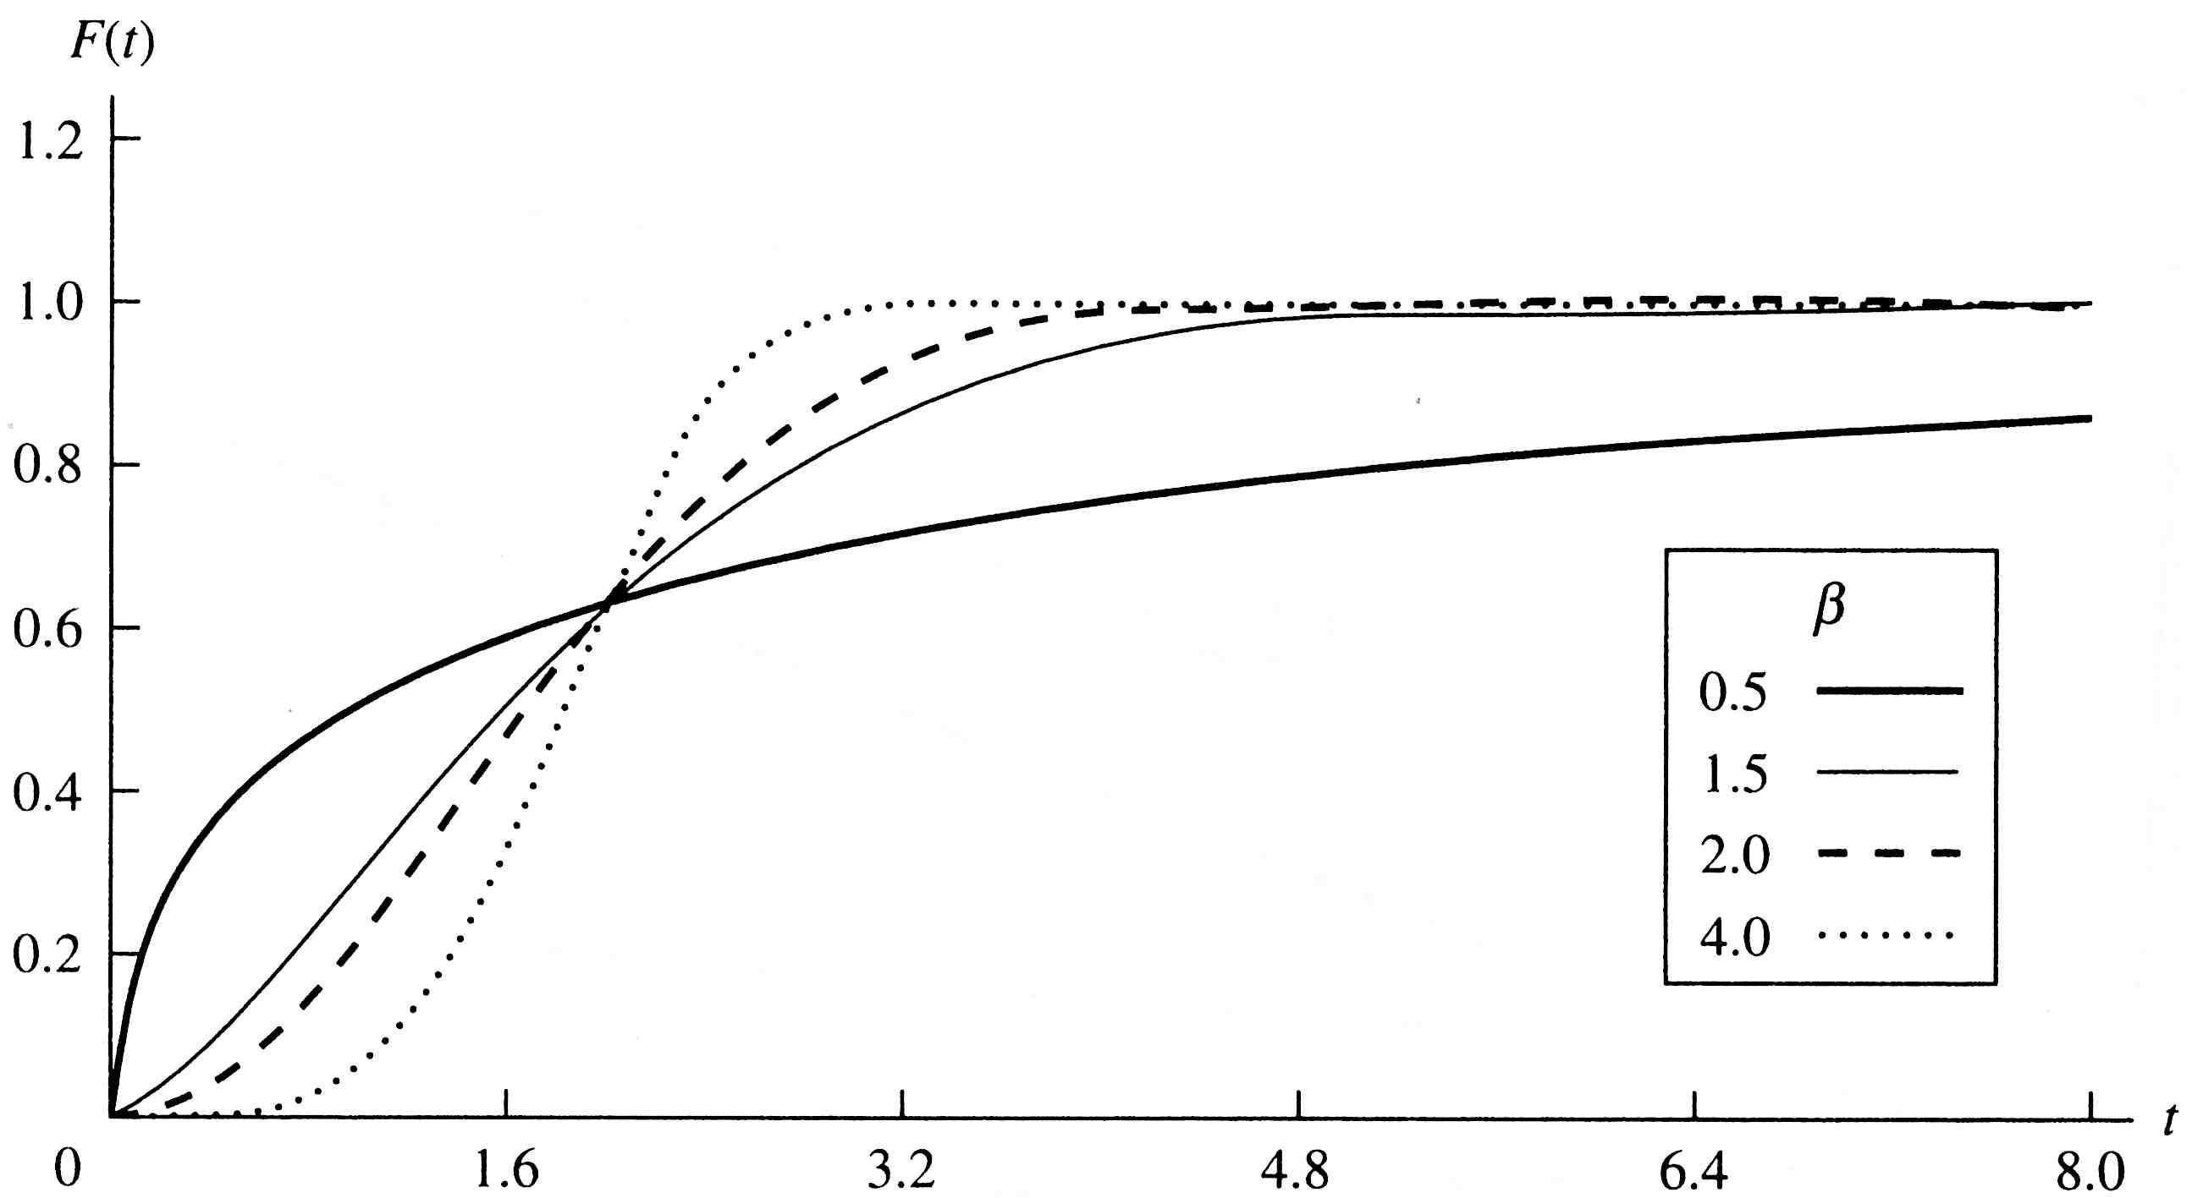
Weibull F(t): Effect of β with θ = 2
θ = 2
Here, θ = t; F(t)=1- e⁻¹ = 0.63
t
Both shape and scale parameters are required for failure distribution characterization

Slide 8
Weibull Failure Rate Function, λ(t)
β
λ(t)
=f(t)/R(t)
θ = 2
β > 1: Increasing Failure Rate (Aging System)
β = 1: Constant Failure Rate
β < 1: Decreasing Failure Rate (Reliability Growth)
The shape of the distribution represents the failure process of the component or system as it develops through time, so modeling with the appropriate distribution shape is essential for optimum failure behavior predictions.
Notes:
A plot of the hazard rate function may suggest that the Weibull is IFR for beta greater than one and DFR for beta less than one. Of course, analyzing the function itself should tell us this. What happens when beta = 1?

Slide 9
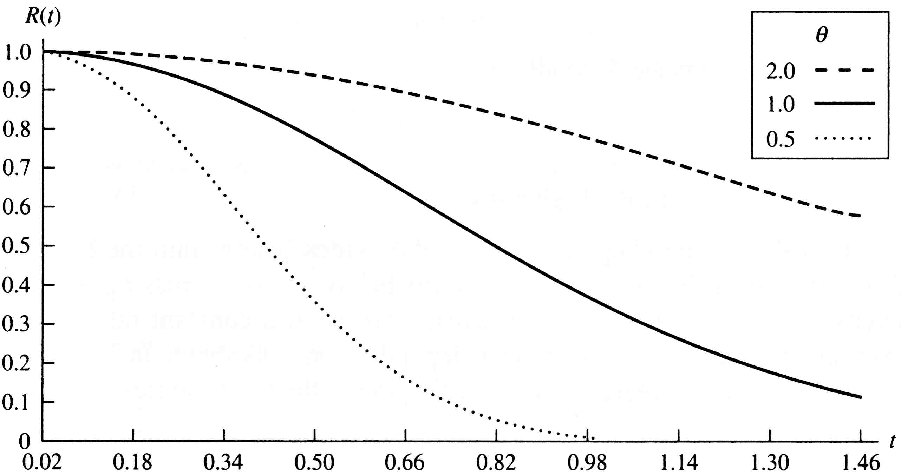
Weibull R(t): Effect of θ with β=1.5
β = 1.5
θ ~ 2
θ ~ 1
θ ~ 0.5
R(t) broadens and reliability decreases more slowly as θ is increased, but it has same basic shape set by β.

Slide 10
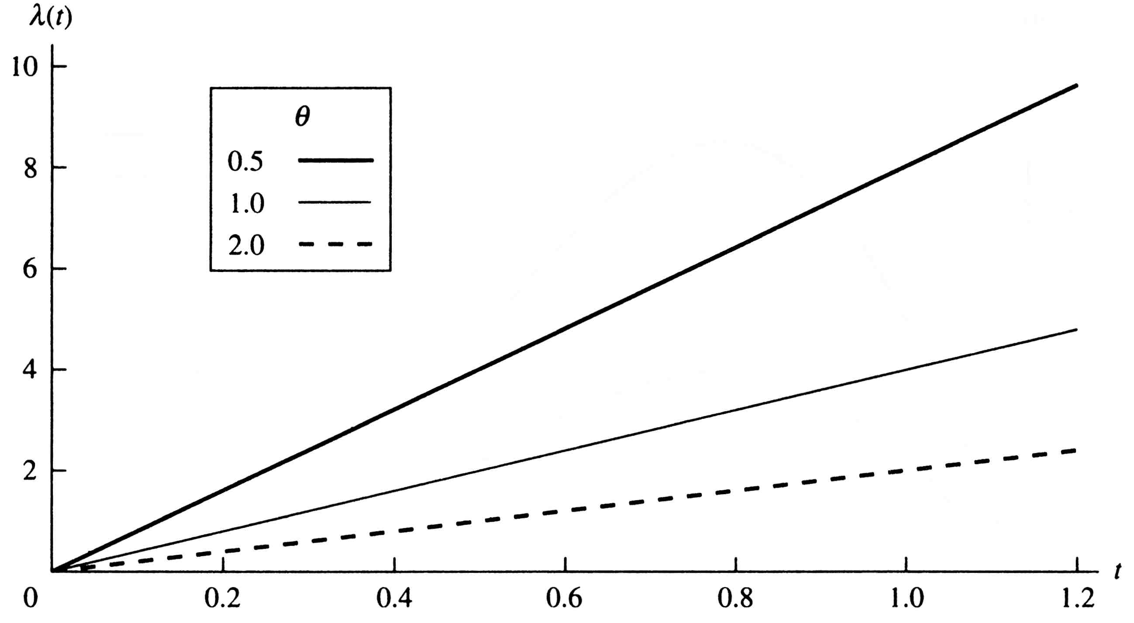
Weibull λ(t): Effect of θ with β=2
The Characteristic Life parameter 𝛉 influences the mean and the dispersion or spread of the Weibull distribution
β = 2, IFR
θ ~ 0.5
θ ~ 1.0
θ ~ 2.0
As θ is increased, the slope of λ(t) decreases and the distribution broadens, but the linear shape set by β remains the same.

Slide 11
Weibull MTTF
IRME, Tab A.9
Use Gamma Function table if x is not an integer.
Notes:
Since we mentioned the mean, here is the formula for finding it. Because numerical integration is involved, the MTTF is more difficult to find than it was for the exponential. There is no simple formula. However, the integration can be expressed in terms of the gamma function and use made of a table of gamma values. An example of a gamma table is provided in the next slide and may be found in an appendix to your text. Be sure understand how to use the table and how to evaluate the gamma function. Note that the mean approaches the characteristic life as beta increases.

Slide 12
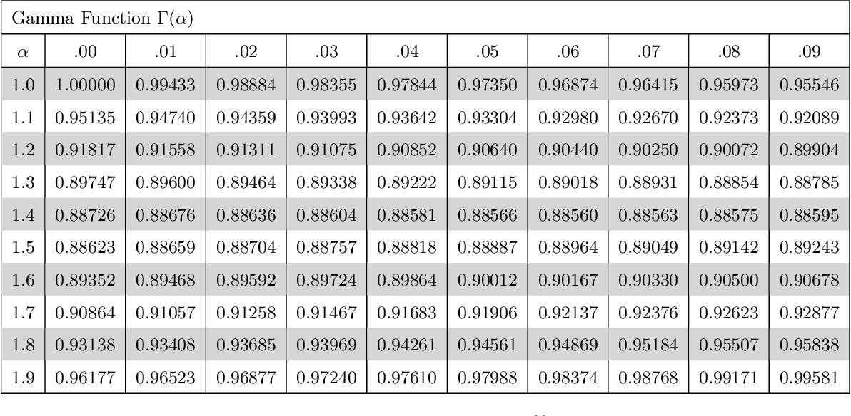
Gamma Function – Selected Values

Slide 13
Example Problems
Effect of β, same θ
Let T = a random variable, the time to failure of a circuit card. T has a Weibull distribution with β = 0.5 and θ = 500K hours
Find R(50,000) and the MTTF.
Let T = a random variable, the time to failure of a fuse.
T has a Weibull distribution with β = 1.5 and θ = 500K hours
Find R(50,000) and the MTTF.
Γ(x) = (x-1)! = 2! = 2
=1.67
DFR because β < 1
IFR because β > 1
Notes:
Ahhhh! Our first example, and it is about time. Two Weibull distributions are given. One with a DFR and one with an IFR.

Slide 14
Effect of β on Variance and Standard Deviation
Derive the variance and σ for Exponential with β = 1:
σ² = θ²(2 - 1) = θ² = (1/λ)² as is known for Exponential
Notes:
Once the mean of a distribution is presented, the variance cannot be too far behind. Here it is. Again the gamma! As beta increases, the variance decreases. Does this result have any practical use?

Slide 15
Example: Effect of β on Standard Deviation
θ = 500
β = 0.5
θ = 500
β = 1.5
2.33
1.67
Much smaller σ with β = 1.5 as seen in f(t):
f(t)
t
Notes:
Be sure you can find the variance of a Weibull distribution.

Slide 16
Weibull Design Life and Median
Set
a targeted value
then
and
Note that when β = 1, the expressions for Exponential appear, showing again that Weibull is an extension of Exponential, and Weibull β = 1 is Exponential!
Notes:
Solving the reliability function for its inverse gives us the design life. A design life where R = .5 is the median. Often design lives of one percent or .1 percent are of interest. What would they be for our two examples?

Slide 17
Weibull Mode
We showed t_{mode} = 0 for Exponential, Weibull β = 1
Notes:
The mode will occur at the origin for beta less than or equal to 1. As an exercise, find derive the above formula for the case where beta is greater than one.

Slide 18
Example: Compare Design Life, Median, & Mode
Effect of β at constant θ
θ= 500
β = 0.5
t_{0.9} = 500 (-ln 0.90)²
= 5.55
t_{med} = 500 (0.69315)²
= 240
t_{mode} = 0, (β<1)
θ= 500
β = 1.5 = 3/2
t_{0.9} = 500 (-ln 0.90)^{2/3}
= 112
t_{med} = 500 (0.69315)^{2/3}
= 392
t_{mode} = 500 [1-2/3)]^{2/3}
= 240
1/β
1/β
1/β
Same θ, but notice major differences due to different β
Notes:
Compare the two distributions remembering that they have the same value for theta. Note the significant differences caused by the shape parameter.

Slide 19
Conditional Reliability: Example
Find R(50|50) for Weibull with β = 0.5, θ = 500
θ= 500
θ= 500
β = 0.5; R(50) = 0.7289
R(50|50) = R(100)/R(50) = exp[-(100/500)^{0.5}] / 0.7289
= 0.6394 /0.7289 = 0.8772
β = 1.5; R(50) = 0.969
R(50|50) = R(100)/R(50) =
exp[-(100/500)^{1.5}] / 0.969
= 0.9144 / 0.969 = 0.9437
increased
decreased
Same θ, but notice the significant shift due to different β
Notes:
Did you get the right answers? If not, is your mistake conceptual, mathematical, or simply bad arithmetic? Conceptual – see your instructor; mathematical – continuing reviewing freshman algebra and calculus; bad arithmetic – get a new calculator.

Slide 20
Weibull Conditional Reliability
Note that when β = 1, the Exponential R(t) = exp(-λt) appears due to lack of memory of the Exponential!
Notes:
Using the formula for a Weibull conditional reliability, find R(50|50) for both example distributions. Compare your results with R(50). The answer is on the next slide.

Slide 21
Example- Weibull
A pressure relieve valve has a Weibull failure distribution with a shape parameter of 2.4 and a characteristic life of 10 years. Find:
a. R(5 yrs)
b. MTTF
c. Standard deviation
d. Median and Mode
e. 99% and 95% design life
f. R(5|5)
Notes:
You must have been looking forward to this. Your very own example to work.

Slide 22

Solution
Why is this kind of calculation important?
Notes:
Surely you have gotten these answers?

Slide 23
Solution (continued)
Notes:
And this! Be sure you have mastered all facets of the Weibull distribution before moving on the the next one, the normal probability distribution. The Weibull will certainly become one of your all time favorites.

Slide 24
Identical Weibull Components in Series: Same shape and same scale
If n independent components in series have identical conditional failure rate functions with the same scale and shape parameters:
Notes:
If both the scale and shape parameters are identical for all failure modes then the above result is obtained. When would all the failure modes have the identical distribution? Can you provide an example? What is the characteristic life of the system?

Slide 25
Weibull Components in Series: Same shape, different scale
A system composed of several independent failure modes in series, each with a Weibull failure distribution, will have a system failure rate function equal to the sum of the different failure rate functions.
If all failure modes have the identical shape parameter, then the system also has a Weibull distribution.
which is a Weibull failure rate function with a shape parameter β and a characteristic life for the system, θ_{S} where
Notes:
A system composed of several independent failure modes each having a Weibull failure distribution will have a system hazard rate function equal to the sum of the failure mode hazard rate functions. If all failure modes have the identical shape parameter, then the system will have a Weibull distribution as well. Do you see where the scale parameter came from? What happens when each failure mode has a different beta value?

Slide 26
Example: MTTF for multi-component system
A reactor cooling water system is constructed from 5 modules in series, each exhibiting Weibull distribution failure behavior with β= 1.5. Is the engine system also Weibull ? Why or why not? The characteristic life values (operating cycles) of 3,600, 7,200, 5,850, 4,780, and 9,300. Calculate the θ_{S} , MTTF_{S}, median TTF, and the Reliability of the engine system, R_{s}(t).
Notes:
A system composed of several independent failure modes each having a Weibull failure distribution will have a system hazard rate function equal to the sum of the failure mode hazard rate functions. If all failure modes have the identical shape parameter, then the system will have a Weibull distribution as well. Do you see where the scale parameter came from? What happens when each failure mode has a different beta value?

Slide 27
The Normal Probability Density Function(PDF)
Narrow scale
Broad scale
There is no shape parameter, because the Normal pdf always has a symmetric shape that varies with a wide range, sharp to broad, of scale parameter, σ, and cov (coefficient of variation) = σ/μ.
Notes:
Let us get back to normal. You should already be familiar with this distribution. We start with the density function and graph. The normal has a location parameter (the MTTF) and a scale parameter (the variance or standard deviation). There is no shape parameter since it always has the bell-shape curve. Notice that the domain of a normally distributed random variable goes from negative infinity to plus infinity. Is this a good property for a failure distribution? What is the domain of the exponential and Weibull?

Slide 28
Normal Conditional Failure Rate, Effect of σ
σ = 0.5
IFR
λ(t) = f(t) / R(t)
Broad scale
σ = 1
The Normal failure rate function, λ(t), is always increasing, so it represents only the IFR region of component life and cannot be used for modeling defects that are gradually removed in the DFR region or for constant λ in the CFR region.
Notes:
Interestingly, the hazard rate function is always increasing. Therefore, we would never want to use this distribution for modeling manufacturing defects that are gradually removed. The hazard rate function can only be determined numerically because we cannot integrate in closed form the normal PDF.

Slide 29
Normal Distribution - Applications
Useful for random stresses over time, such as the additive effects of temperature variation, material wear, and friction leading to increasing conditional failure rate, λ(t)
Tool failures
Brake lining wear
Tire tread wear

Slide 30
Finding Normal Cumulative Probabilities
If T is Normally distributed, transform T to Z:
Then Z has a standard Normal distribution with a mean of 0 and a standard deviation of 1. The pdf for Z is given by
The cumulative probability of failure up to time t is the cdf for failure F(t), given by
Notes:
To find normal probabilities, we standardize by subtracting the mean and dividing by the standard deviation. This generates an equivalent normal random variable having a mean of zero and a standard deviation of one. For this random variable, tables of cumulative or (complementary cumulative) probabilities are available. (there is one in the back of the text). Make note of the above notation for the standardize normal PDF and CDF. Is it all Greek to you?

Slide 31
Normal Reliability Function
= 1-F(t)
Standardize to Z:
Z _{T}
Z _{t}
From Tables
Notes:
To find normally distributed reliabilities, we standardize and then go to the normal table.

Slide 32
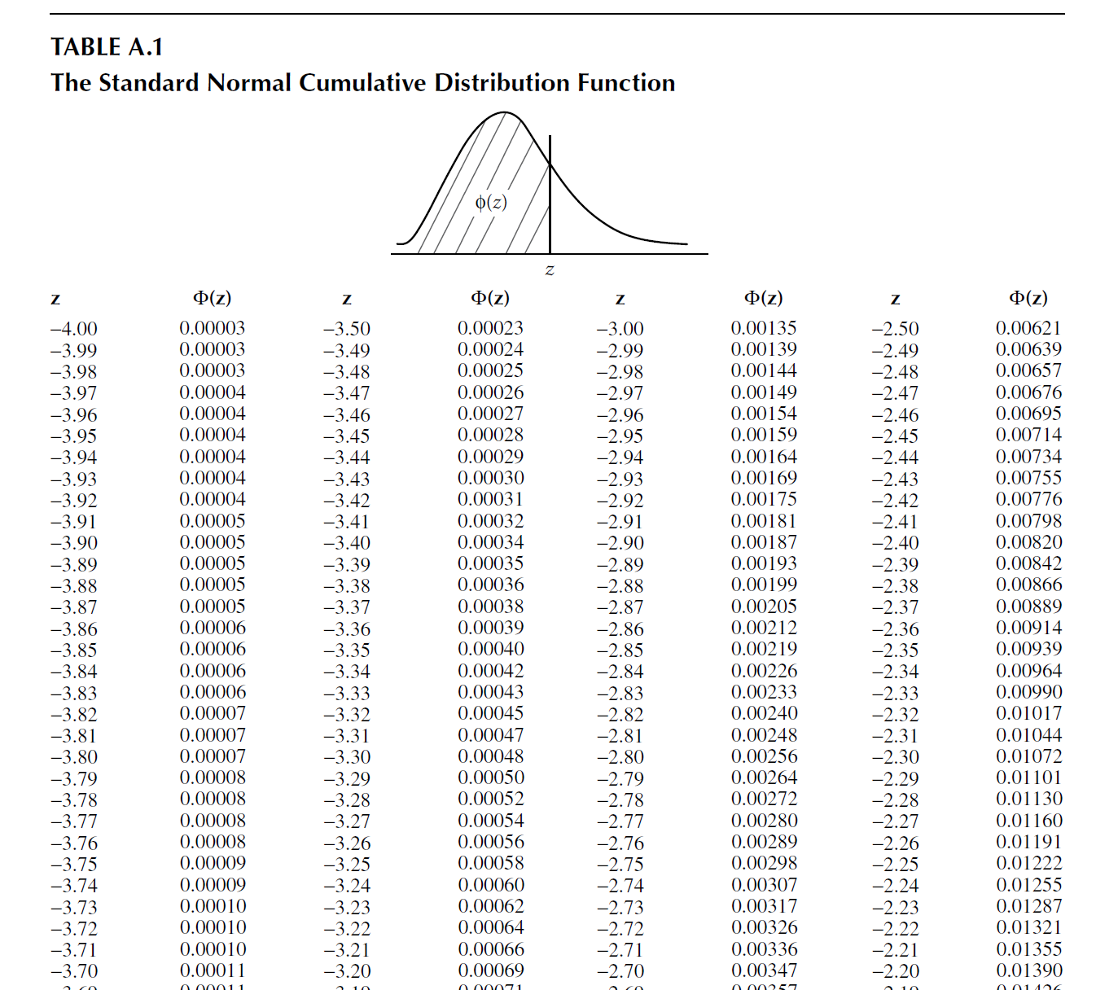
RERA, Table A1, pp 467

Slide 33
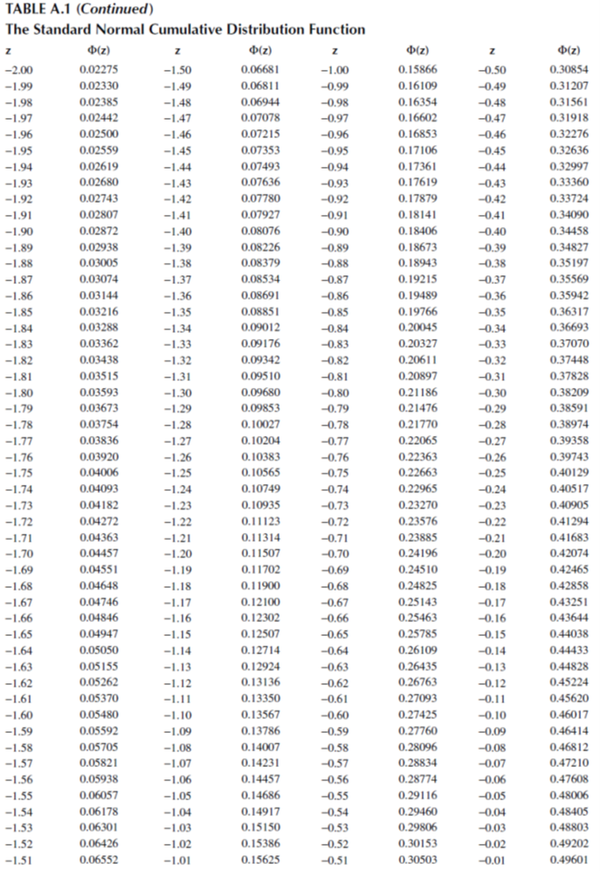

Slide 34
Standard Normal Probability Tables
Z Φ(Z) 1-Φ(Z)
-0.55000 0.29116 0.70884
-0.54000 0.29460 0.70540
-0.53000 0.29806 0.70194
-0.52000 0.30153 0.69847
-0.51000 0.30503 0.69497
-0.50000 0.30854 0.69146
-0.49000 0.31207 0.68793
-0.48000 0.31561 0.68439
-0.47000 0.31918 0.68082
-0.46000 0.32276 0.67724
-0.45000 0.32636 0.67364
-0.44000 0.32997 0.67003
P{Z < - 0.5} = 0.30854
Area under pdf curve up to Z = - 0.5
P{Z > - 0.46} = 0.67724
Area under pdf curve > Z = - 0.46

Slide 35
Example 1– Normal Distribution
The time to failure of a fan belt is Normally distributed with a MTTF = 220 (in hundreds of vehicle miles) and a standard deviation of 40 (in hundreds of vehicle miles).
R(100) = 1 - Φ[ (100-220)/40] = 1 - Φ(-3) = 0.9987
R(200) = 1 - Φ[ (200-220)/40] = 1 - Φ(-0.5) = 0.6915
R(300) = 1 - Φ[ (300-220)/40] = 1 - Φ(2) = 0.02275
R(100|200) = R(300) / R(200) = 0.02275 / 0.6915 = 0.0329
Note: the median = mode = MTTF = 22,000 miles
t μ σ
R(t|T₀)
Notes:
Check these reliabilities with the table values.

Slide 36
Example 2 – Normal Distribution Design Life
A new fan belt is developed from a higher grade of material. The belt has a time to failure distribution that is Normal with a mean of 35,000 vehicle miles and a standard deviation of 7,000 vehicle miles. Find its design life if a 0.97 reliability is desired.
R(t) = 0.97; find t !
F(t)=0.03
So, F[(T - 350)/70]=0.03
From the Normal CDF table, value of Z corresponding to Φ(z)=0.03 is -1.88.
Therefore (t_{0.97} - 350 ) / 70 = -1.88
So, t_{0.97} = 218.4 or 21,840 vehicle miles
(Values taken in hundreds of vehicle miles units.)
Notes:
Be sure you can work a problem in reverse to find a design life. In this case, we enter the normal table with a reliability (complementary cumulative probability) and find the corresponding z value. Then we solve for t using the relationship t = μ + σ z. For a design life of 0.90, what is the corresponding z value? What should the sign of z be, positive or negative?

Slide 37
Example 3- Normal Distribution
The operating hours until failure of a halogen headlamp is Normally distributed with a mean of 1200 hr and a standard deviation of 450 hr.
Find:
a. The 5-year reliability if the driving results in the use of the headlamp an average of 0.2 hr a day.
b. The 0.90 design life in years.
Notes:
Try your luck with one; answers follow.

Slide 38
Example 3- Solution
a. t = 0.2 hr./da. x 365 day/yr x 5 yr = 365 hr.
R(365) = 1 – F[(365 - 1200)/450] = 1 – F[-1.86] = 0.9686
b. R(t_{0.90}) = 0.90
or F[(t_{0.90} - 1200)/450] = 1-0.90=0.1
Find value of Z corresponding to Φ(z)=0.1 (Z=-1.28)
(t_{0.90} - 1200) / 450 = -1.28
t_{0.90} = 1200 - 1.28 (450) = 624 hr.
or t_{0.90} = 624 / (0.2 x 365) = 8.5 yr.
Notes:
Be sure you can work this type of a problem.

Slide 39
The Lognormal Failure Process
Let T = a random variable, the time to failure.
If T has a Lognormal distribution, then the logarithm of T has a Normal distribution.
Here the parameters are median (more representative than mean for skewed) and shape parameter s (~ σ).
some normal logs ☺
Notes:
As we deviate from the normal, we turn our attention to the lognormal. The lognormal has often been used a repair distribution. Later on we will discuss maintainability and the repair probability distribution in detail. We will be taking advantage of the relationship between the normal and the lognormal distribution. (Perhaps that is where it gets its name; what do you think?)

Slide 40
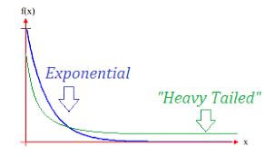
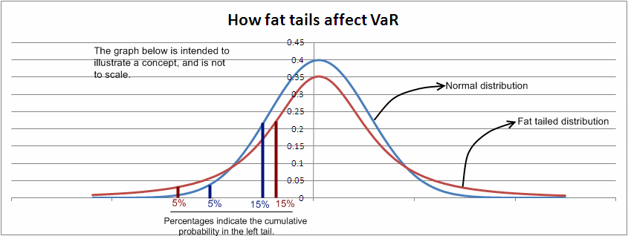

Slide 41
Lognormal Density Function, Effect of Shape Parameter, s
Defined for only positive value of t.
More symmetrical for smaller s values
s = 0.1
s = 1
t_{med} = median time
to failure, location parameter
s = shape parameter
cov = coefficient of variance
s = 0.5
Lognormal pdf is sometimes represented in terms of the mean and std. dev. of the underlying Normal distribution.
Notes:
The PDF look almost like the normal PDF. We will define the parameters of the lognormal to be its median (a location parameter) and its shape parameter s. Others will define the parameters of the lognormal in terms of the mean and standard deviation of the underlying normal distribution. Therefore, you must be careful and always be aware of how the parameters are being defined when using this distribution. As you will see, there are formulae for converting from one set to the other.

Slide 42
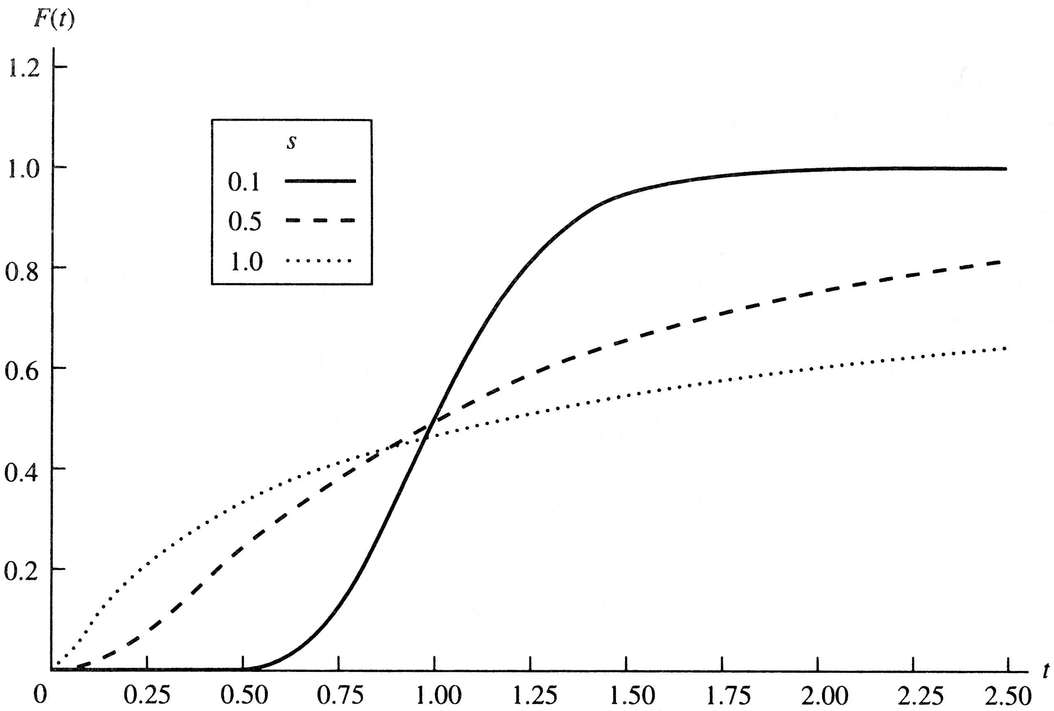
Lognormal F(t), Effect of Shape Parameter, s
F(t)
s = 0.1
~ Normal
s = 0.5
s = 1.0
~ Exponential
As s increases, the variance increases and the distribution becomes more asymmetric.
Data represented by Weibull will often be represented satisfactorily also by Lognormal.

Slide 43
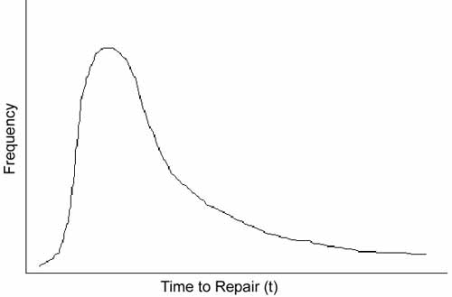
Application: Repair Times
Majority of repair times near Mode
Long repair times
Short repair times
The Lognormal distribution is widely used to describe the frequencies of system repair, because it reflects common duration repair-times, a large number of repairs closely grouped about a modal value, and long repair time data points with decreasing frequency in the tail.

Slide 44
Lognormal/Normal Relationship
Given T is a lognormal random variable, then
Distribution Lognormal Normal
Mean ln t_{med}
Variance s², σ = S
Mode ln t_{med}
T space
Log T space
Notes:
Hey! Here are the formulae. The natural log of the median of the lognormal distribution is the mean of the underlying normal. The shape parameter of the lognormal is the standard deviation of the underlying normal. Don’t confuse the mean and standard deviation of the underlying normal with the mean and standard deviation of the lognormal. The lognormal is entitled to have its own mean and standard deviation. You need o be able to use all of the above relationships.

Slide 45
Lognormal Failure and Reliability Distribution
Pr of failure up to t
Values in Standard Normal tables
Notes:
“How do I find lognormal reliabilities,” you ask? Quite simply, we use the underlying normal distribution and the normal table. Can you follow the above steps to get an expression for R(t)? If not, you might ask your instructor to talk you through it.

Slide 46
Lognormal Design Life
Specify R
Find Z in the Normal table
Calculate t_{R}
Find z_{1-R} such that:
Solve for t_{R}
Notes:
The derivation of the design life (and hence the median) is straightforward. To find a design life, the normal probability table will be used. First,
R is specified,
then the corresponding z value found in the normal table,
and finally the formula shown is used to find t_{R}.

Slide 47
Lognormal Example
The failure distribution of an exhaust system is Lognormal with t_{med} = 50,000 vehicle miles and s = 0.8 (so it is a broad distribution). Therefore:
a. MTTF = 50,000 e^{0.64/2} = 68,856 mi.
b. t_{mode} = 50,000 / e^{0.64} = 26,640 mi.
c. Variance = 50,000² e^{0.64} [e^{0.64} - 1] and the standard deviation = 65,195 mi.
S²=0.64
Notes:
Let’s put all this theory to practice. An example suitable for the discriminating student.

Slide 48
Lognormal Example (continued)
Z_{t}
Calculate the conditional reliability:
R(10,000 | 10,000) = R(20,000) / R(10,000) = 0.8749 / 0.9770 = 0.8955
Notes:
Finding lognormal reliabilities is not only easy, its fun!

Slide 49
Lognormal Example (continued)
Find the design life corresponding to a 90 percent reliability.
Find Z
From the standard Normal probability tables:
Z_{t} = -1.285 corresponds to Pr = 0.90, 1-𝚽(Z_{T}) and 0.1, 𝚽(Z_{T})
Notes:
Ah ha! The design life.

Slide 50
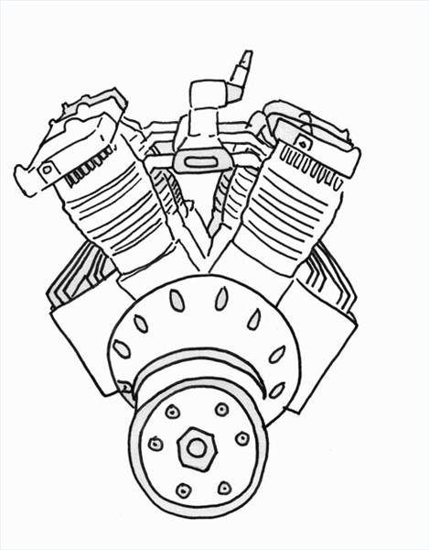
Lognormal Example 2
Reliability testing of a new 1.6 liter automotive engine has resulted in a time to failure distribution that is lognormal with t_{med} = 100,000 mi. and s = 0.70. Find:
a. R(36,000 mi.)
b. MTTF and Std. Dev.
c. R(64,000|36,000)
d. t_{0.95}
Notes:
Now its your turn. There is a severe penalty if you look ahead at the answers before you have tried solving the problem.

Slide 51
Lognormal Example 2 - Solution
a. R(36,000) = 1 – F[(1/0.7)ln(36,000/100,000]
= 1 - F[ -1.46] = 0.92785
b. MTTF = 100,000 e^{0.49/2} = 127,762 mi.
Var = 100,000² e^{0.49} [ e^{0.49} -1] = 1.032 x 10¹⁰
Std Dev = 101,594 mi.
c. R(64,000|36,000)
= R(100,000)/R(36,000)
= 0.5/ 0.92785 = 0.54
Notes:
Be sure you can solve lognormal problems.

Slide 52
Lognormal Example 2 - Solution
d. R(t_{0.95}) = 0.95
1 - F[ (1/0.7) ln(t_{0.95} /100,000) ] = 0.95
(1/.7) ln(t_{0.95} /100,000) = -1.645
t_{0.95} = 100,000 e^{-1.645 x 0.7} = 31,616 mi.
general approach:
Notes:
You may think that it does not get any better than this. However, you will be mistaken. Wait until you see what lies ahead in the next chapter.

Slide 53
The Gamma as a Failure Distribution
Density function, pdf with 2 parameters with a positive integer shape parameter, k
𝛾 (= k), shape parameter; α (= 1/λ), scale parameter
Mean = 𝛾α = MTTF
Variance = 𝛾α²
t_{mode} = α(𝛾-1) for 𝛾 > 1
0 otherwise
Exponential for 𝛾 = 1, CFR
the incomplete gamma function
(Values in tables)

Slide 54
Gamma Distribution Behavior
The Gamma distribution is similar to the Weibull by providing a wide range of shapes. When shape parameter 𝛾 = 1, the density function is Exponential with mean = α = 1/λ
As shown below, the Gamma failure rate function λ(t) behavior depends on the shape parameter 𝛾 and approaches 1/α as t ∞. Gamma Weibull λ(t)
0 < 𝛾 < 1 0 < β < 1 DFR
𝛾 = 1 β = 1 CFR
𝛾 > 1 β > 1 IFR

Slide 55
Example: Gamma Failure Distribution
Failures of a critical machine part due to cyclical vibration has a Gamma distribution with a shape parameter of 𝛾 = 2.3 and a scale parameter of α = 2000 operation hours.
MTTF = 𝛾α = (2.3)(2000) = 4600 hr
Median = 3953 hr (note Median < MTTF due to the skewed distribution tail to large values of t)
R(t = 1000 hr) = 0.946 (R(t) and median calculated in AgenaRisk)

Slide 56
Summary
Reliability
MTTF
Variance
Exponential
Weibull
Normal
Lognormal
Gamma
𝛾α
𝛾α²

Slide 57
Time-Dependent 2-Parameter Reliability Models
Weibull Distribution: A versatile reliability model where shape parameter β represents the progression of a component life cycle: β < 1 for decreasing λ, β = 1 for constant λ (Exponential), and β >1 for increasing λ
Normal (Gaussian) Distribution: Defined for failures that are primarily the result of many small additive effects. Failure rate λ(t) represents only the IFR region (failure rate increases with time).
Lognormal Distribution: Defined for positive values of t and especially suitable when failures are the result of multiplicative effects. Because of a skewed tail of f(t) to larger t, it is useful for modeling repaired systems’ frequency of failure and other skewed distribution applications.
Gamma Distribution: A versatile reliability model similar to Weibull. Being in the same family of distributions as Exponential and Poisson, Gamma is useful also as a Prior distribution for Bayesian parameter updating to Gamma Posterior with Exponential or Poisson as the likelihood function.

